Slide 1
Seismic Activity on the
San Andreas Fault
Group 2
Jeremy Young
Colton Hill
Josh Peterson
Notes:
Introduction

Slide 2
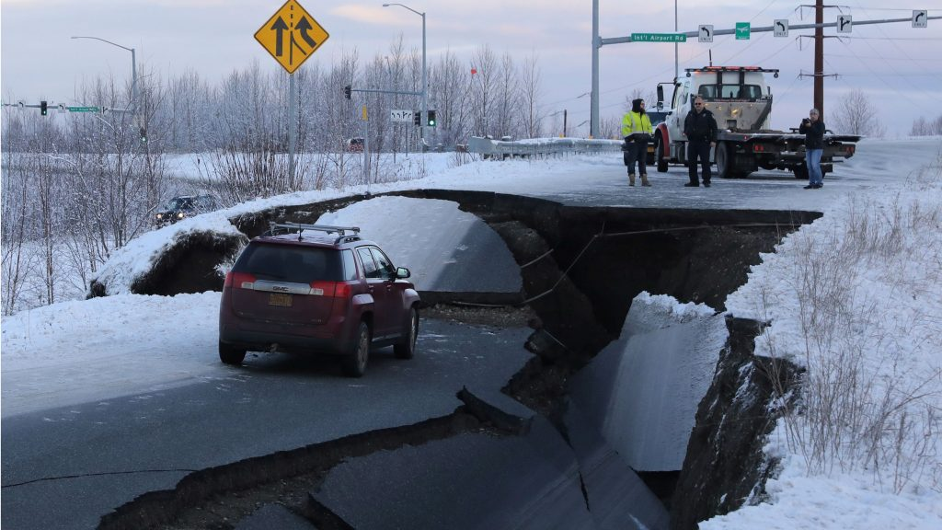
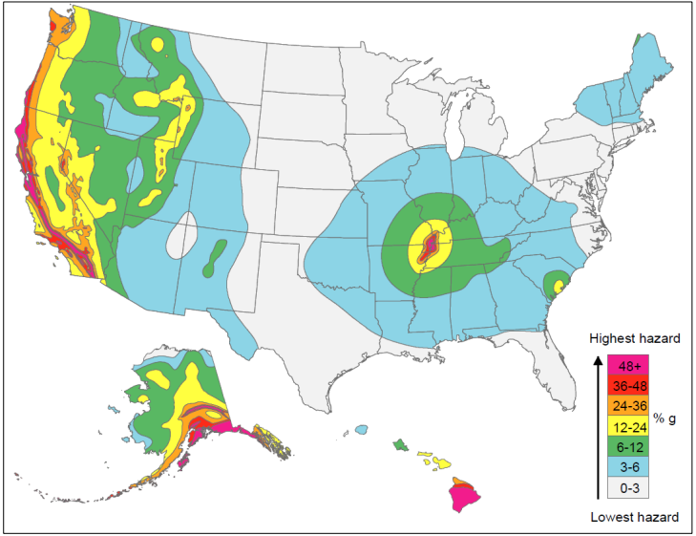
Project Motivations/Goals

Slide 3
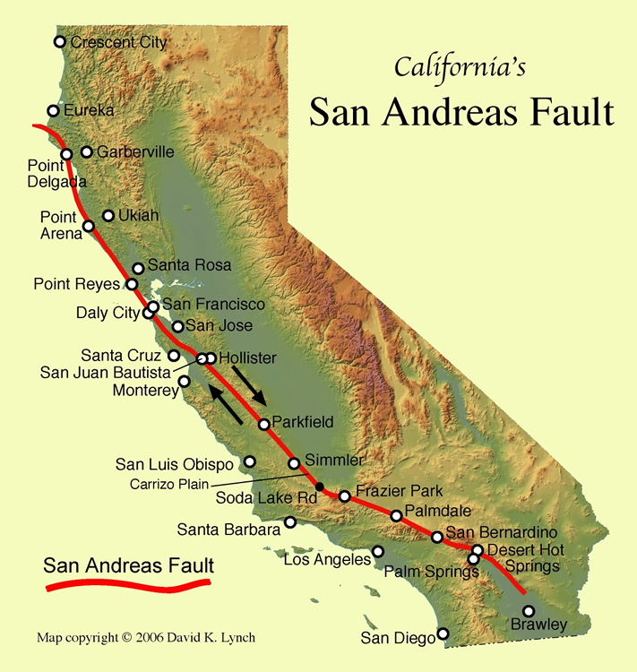
Dataset Description
Provided by 2006 IEEE Visualization Design Contest
Terashake 2.1 Simulation of a magnitude 7.7 earthquake occurring at the Southern San Andreas Fault
Computed using the San Diego SuperComputer (SDSC) DataStar computer
Validated by running simulations for historic earthquakes and comparing results to real-life measurements

Slide 4
Dataset Description
3 Scalar fields (X,Y,Z) representing wave speed, separated into 227 timesteps each
~ 72GB of data
Combined into one volume using the calculator filter to get the magnitude: sqrt(X^2 + Y^2 + Z^2)
CSV of California's overlays (Borders & Highways) Latitude and Longitude Points

Slide 5
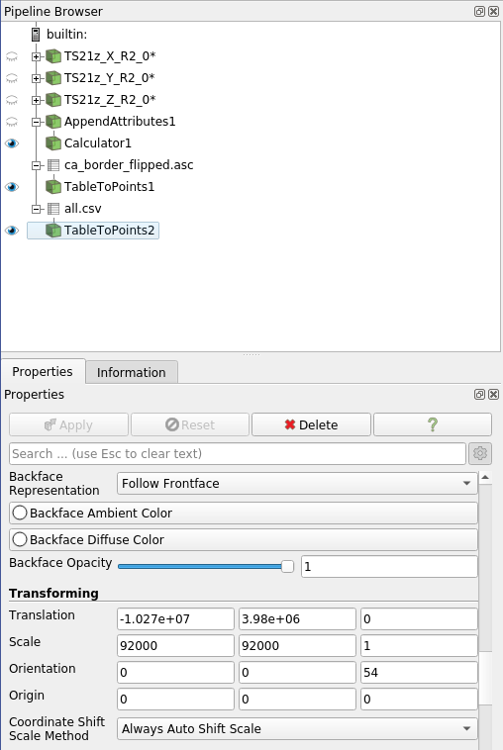
Paraview Pipeline
Convert Raw Files to VTK format using Python script
Load in X,Y,Z scalar fields as time series
Append a Calculator attribute (mag)
Load and Table California’s Borders (CSV)
Scrape California’s Highways data into a CSV Map
Adjust Transfer Function and wait…

Slide 6
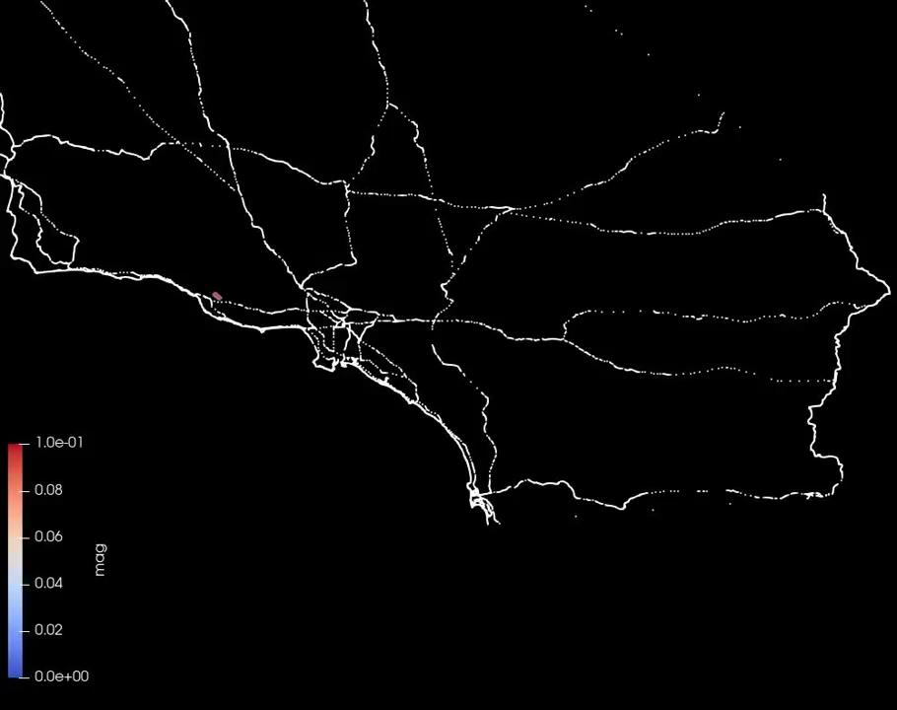

Animations
Cropped Full Spectrum
Cropped High Spectrum

Slide 7
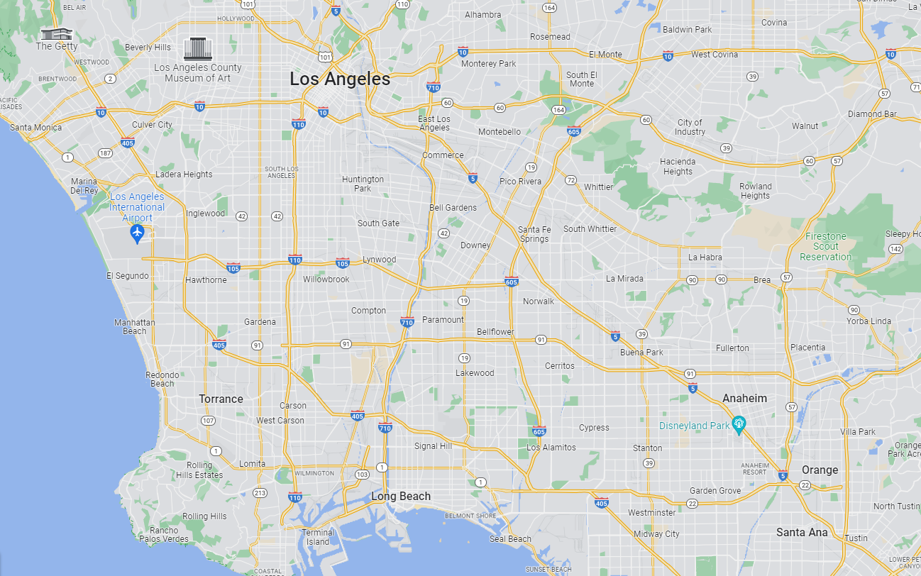
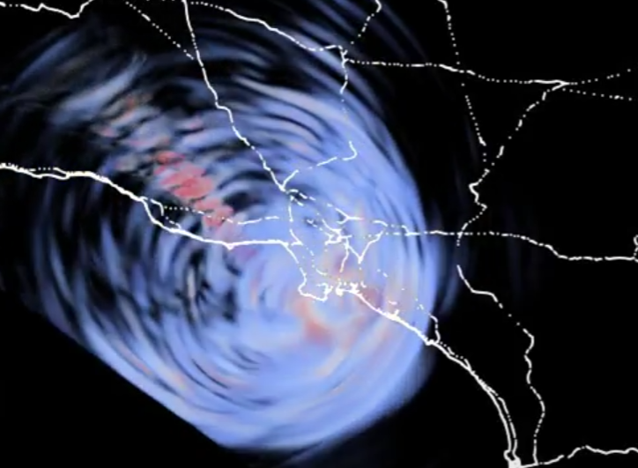
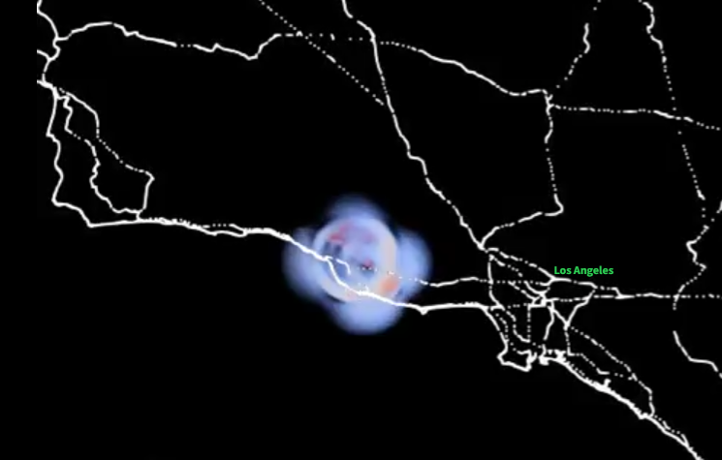
Epicenter and Los Angeles

Slide 8
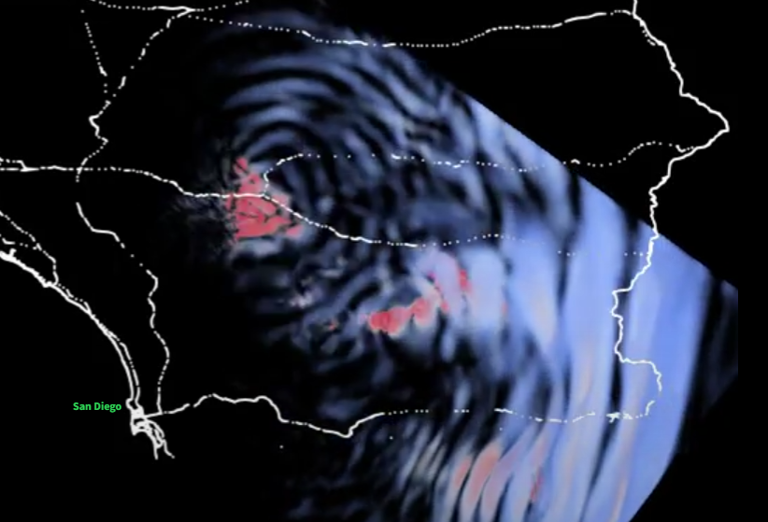
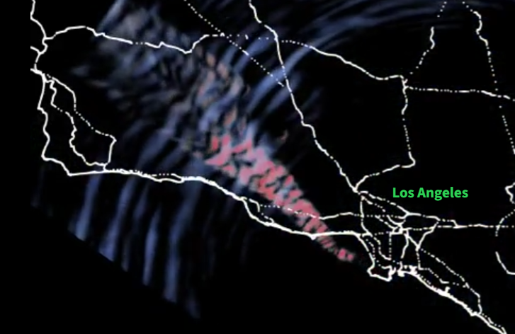
Post-event Reverberations
Notes:
If you look at our a sn

Slide 9
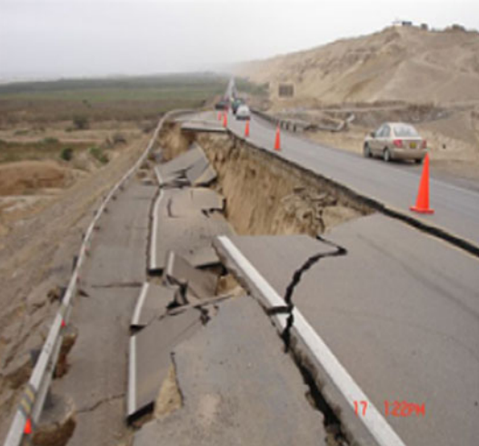
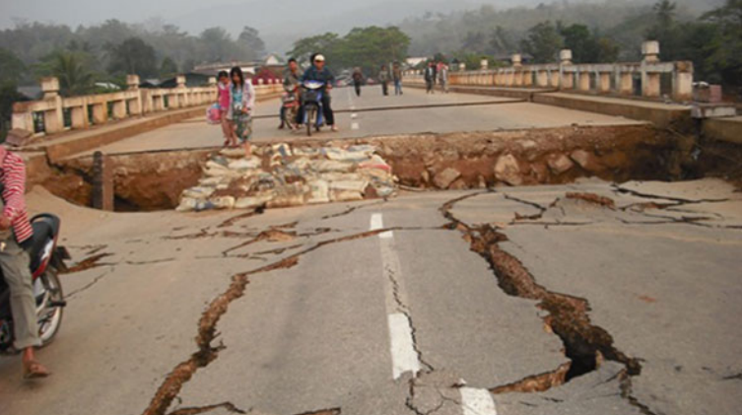
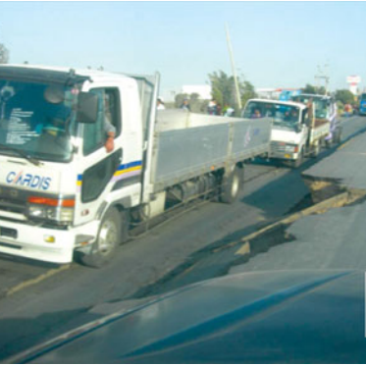
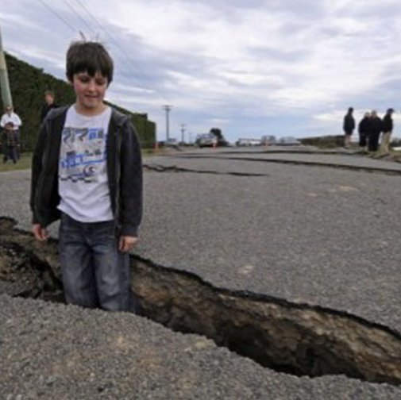
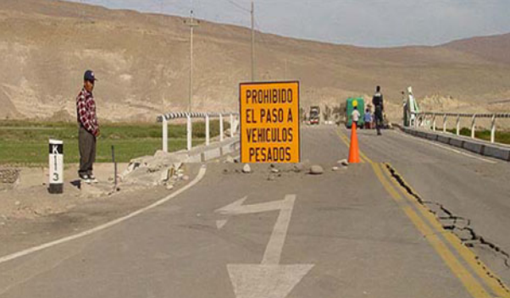
Road Damage Scale (RDS)
5
4
3
2
1
Notes:
5 - very high damage, close to epicenter, roads rendered useless
4 - high damage, partly inaccessible
3 - moderate damage, partially blocked
2 - less damaged, accessible minor repairs needed to function effectively
1 - very minor damage, completely accessible

Slide 10
Affected Highways
Highly Affected (RDS 5-3)
Slightly Affected (RDS 3-1)
ST-1, US-101, ST-23, ST-33, ST-118, I-5, I-405, ST-2, I-10, I-110, ST-22, I-710, I-605, ST-14, ST-138, ST-134, I-210, ST-14, I-15, ST-18, US-395, ST-58, ST-79, I-40, ST-62, ST-166, I-8, ST-7, US-95
ST-178, ST-48, ST-135, ST-99, ST-46

Slide 11
Challenges
Troubles in Paraview
Troubles Data Source
Data not in same coordinate system
No clear mapping from velocity to damage
Not much information on road damage caused by earthquakes
Data conversion utilities were broken
Geographic positioning of data was wrong
Dataset size was big, uncompressed inflated to 72G.

Slide 12
Questions?
Praises?

